Slide 1
A Drop for Life
A Blood Donation Website

Slide 2
Our Team
Meghana Sai Vattikuti
Saranya Machavaram
Payal Nagaonkar
Gayatri Santhi Kumar
Yuktaba Gohil

Slide 3
Table of Contents
Introduction and what we worked on
Project Flow
Software/Technology used
Each Page and its Significance

Slide 4

Introduction
Every two seconds, someone needs blood.
Since blood cannot be manufactured outside the body and has a limited shelf life, the supply must constantly be replenished by generous blood donors.
There are many reasons patients need blood.

Slide 5


Introduction
Hosting Blood Drives
Blood donor basics
Making people aware
Donation Methods
This can be done in multiple ways
Blood vans, Mobile Blood drives according to location.
Have a basic understanding regarding blood types and diseases
Making people aware about the blood drives near to them.
Eg- Blood Banks, Hospitals

Slide 6
What have we worked on
Home Page
Nav Bar
Register/Login
Find Blood Centre Page
Contact Us
Booking Appointment
We have developed a website for Blood donation and finding various resources to do so.
Main face of the website
Differs with each page.
Has navigation to other pages
User can make an account
Contact Us Page with Map and Form Submission
Listing of Blood banks and Pick-up form
Users can book appointment

Slide 7
Software/Technology used
Frontend
Backend
Database
React Js, Bootstrap
Node Express JS
MongoDB

Slide 8

“The blood you donate gives someone another chance at life”

Slide 9
Our Project Layout

Slide 10
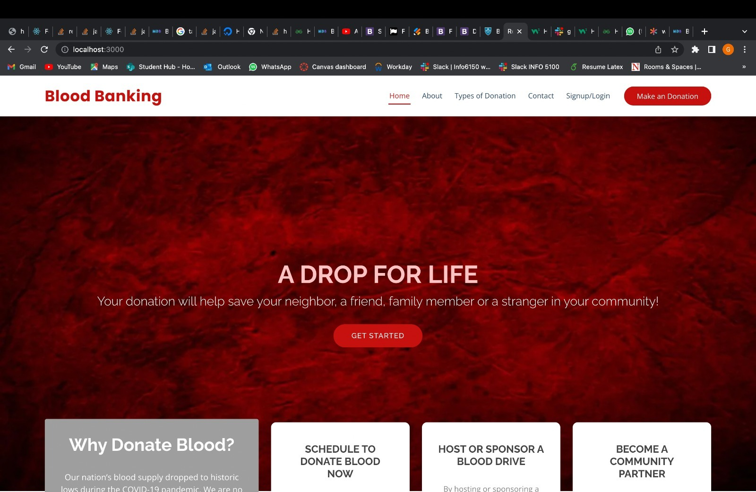
Home Page
Home Page View
This is the main face of the website.
We have put a nav bar which depends on whether the user has logged in or not.
Before Login, we have components like Home, About, Types of Donation, Contact and Sign up/Login.
After Login, we have components like Home, Find a blood centre, Donate a blood, Donate eligibility, Contact, Logout.

Slide 11
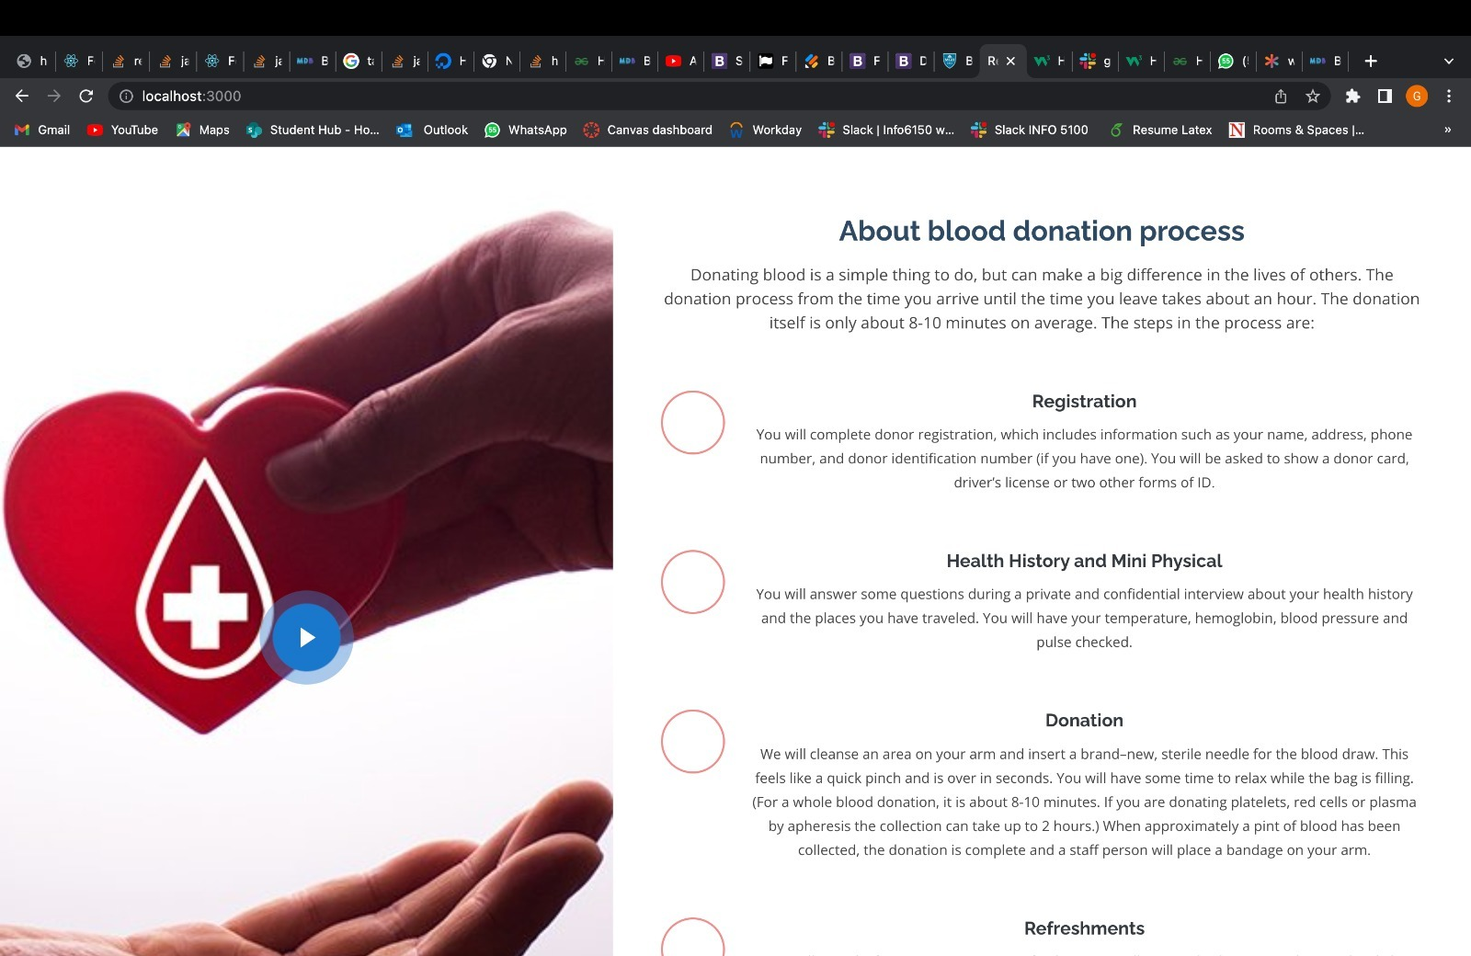
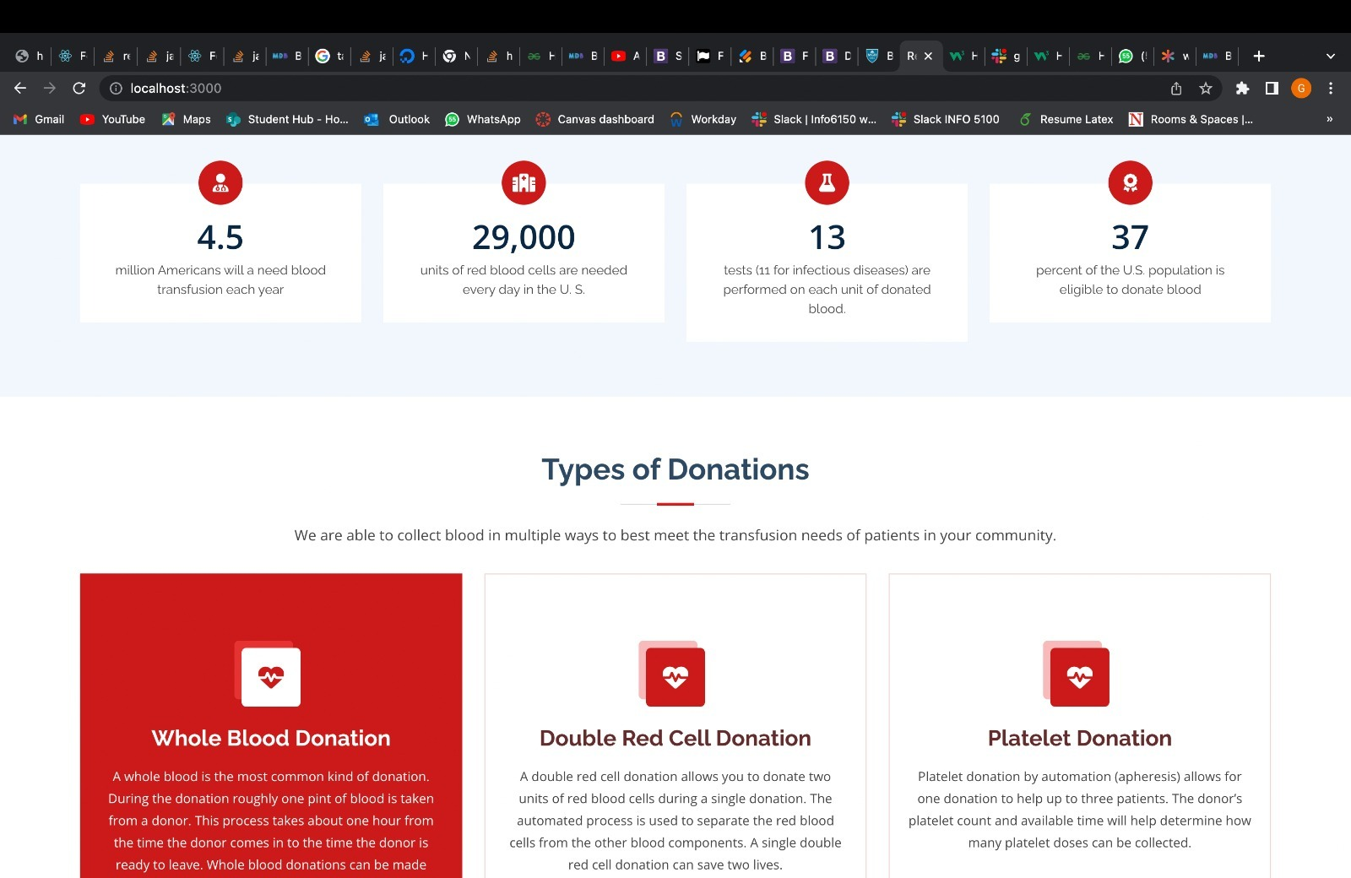
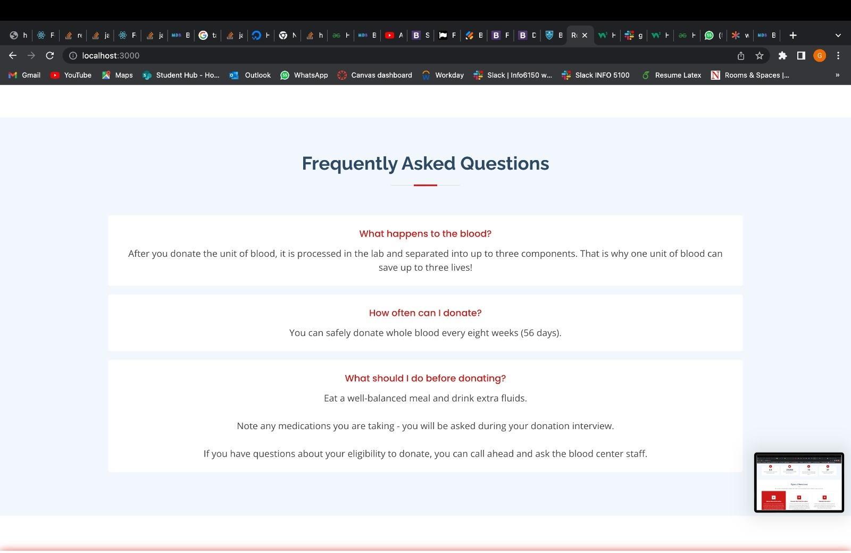
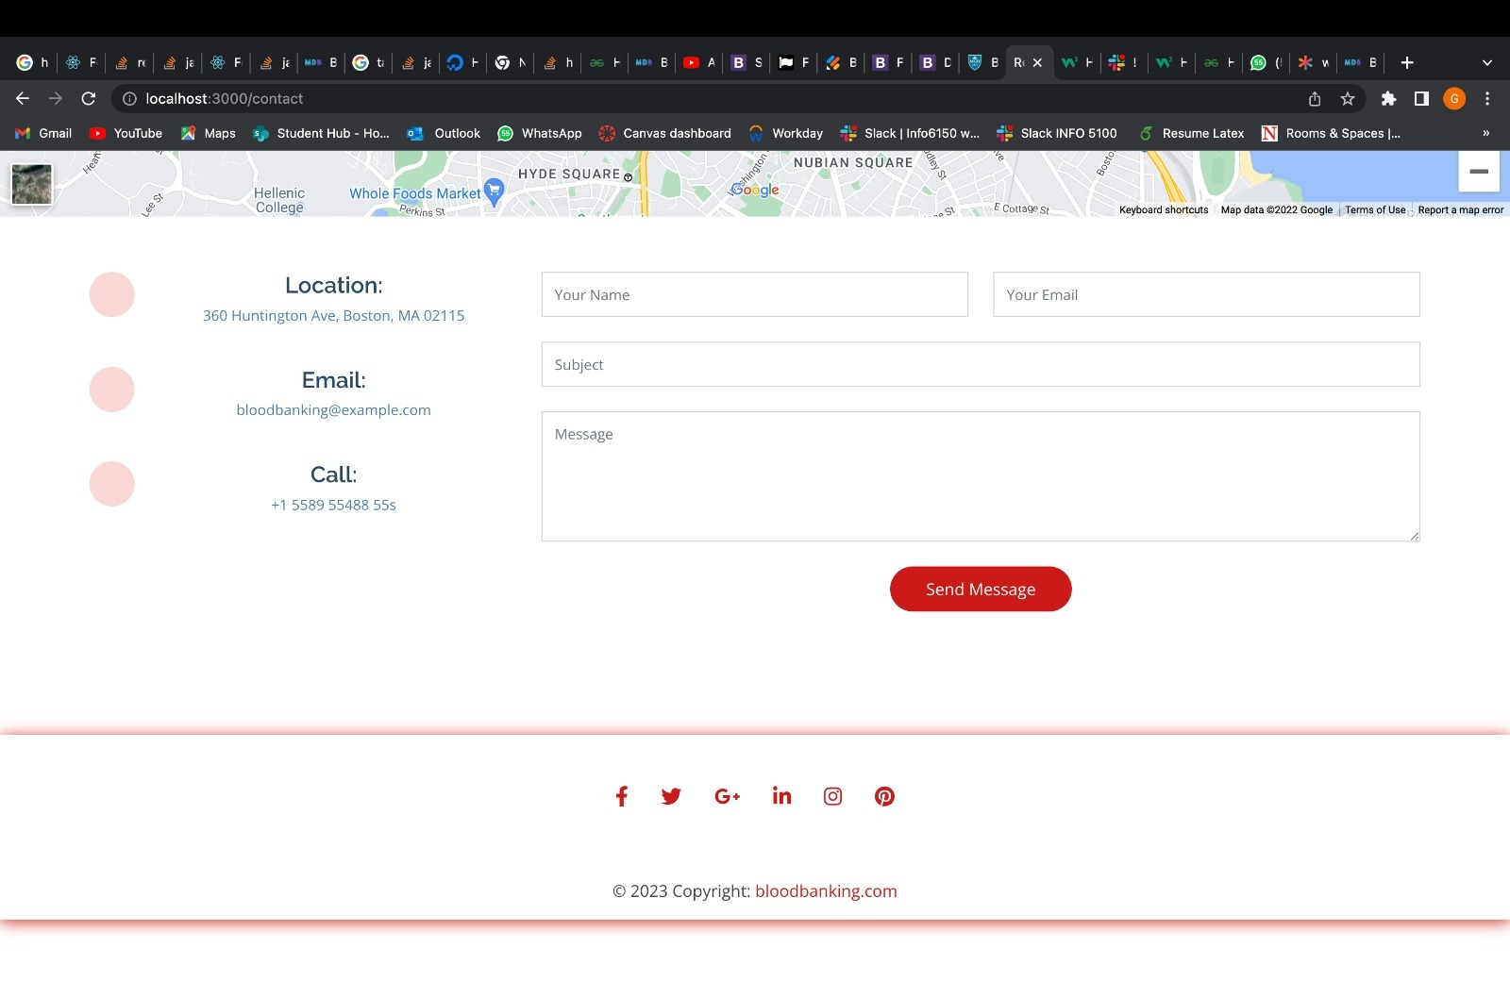

Slide 12
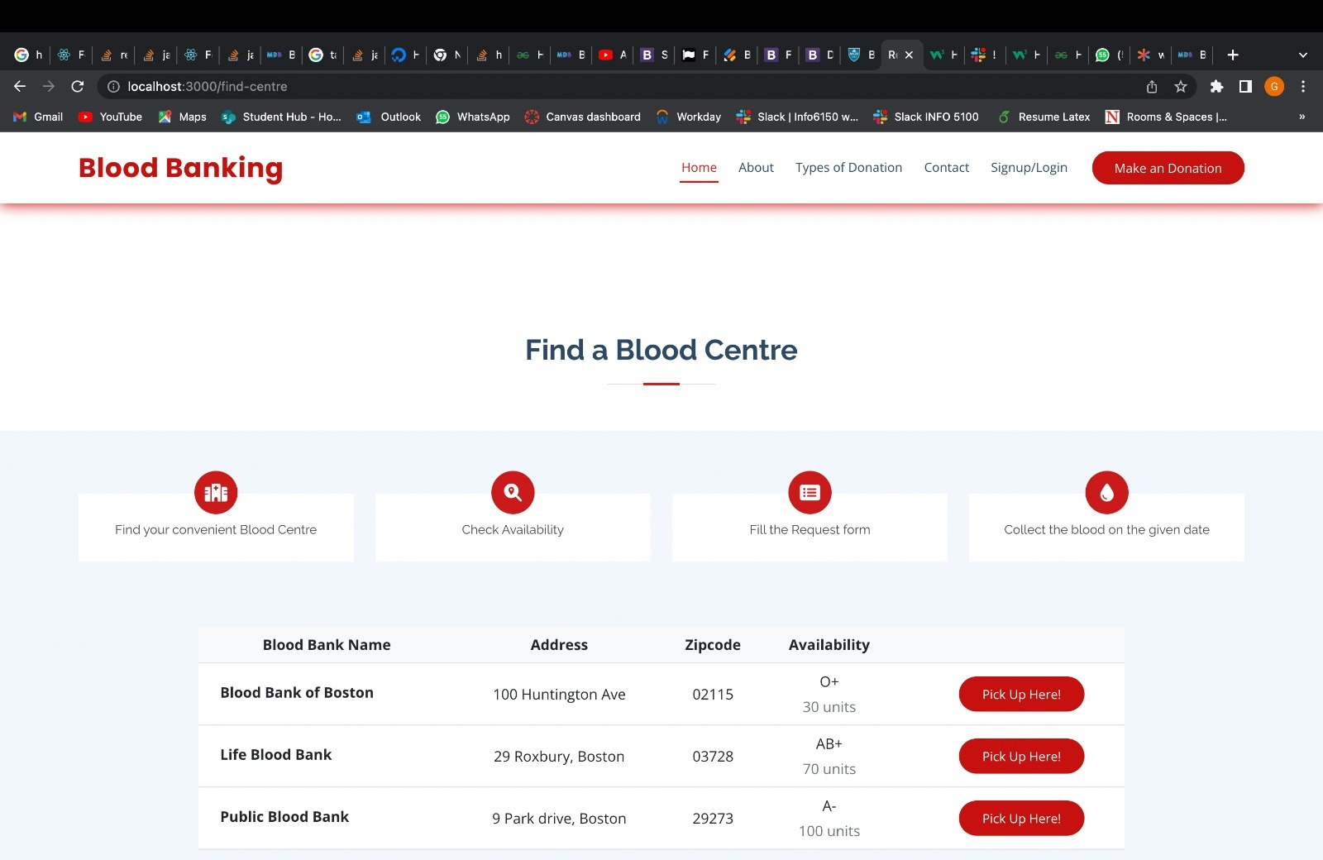
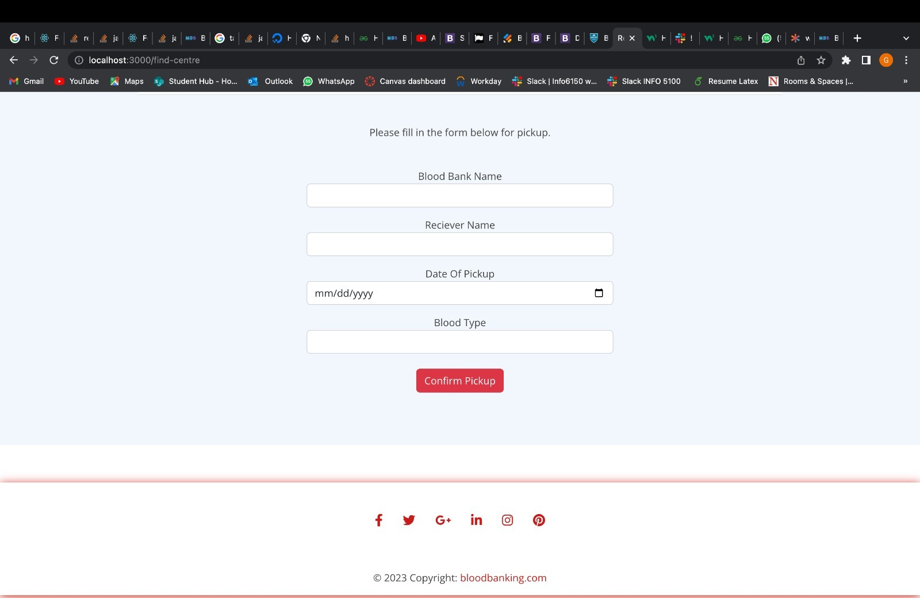
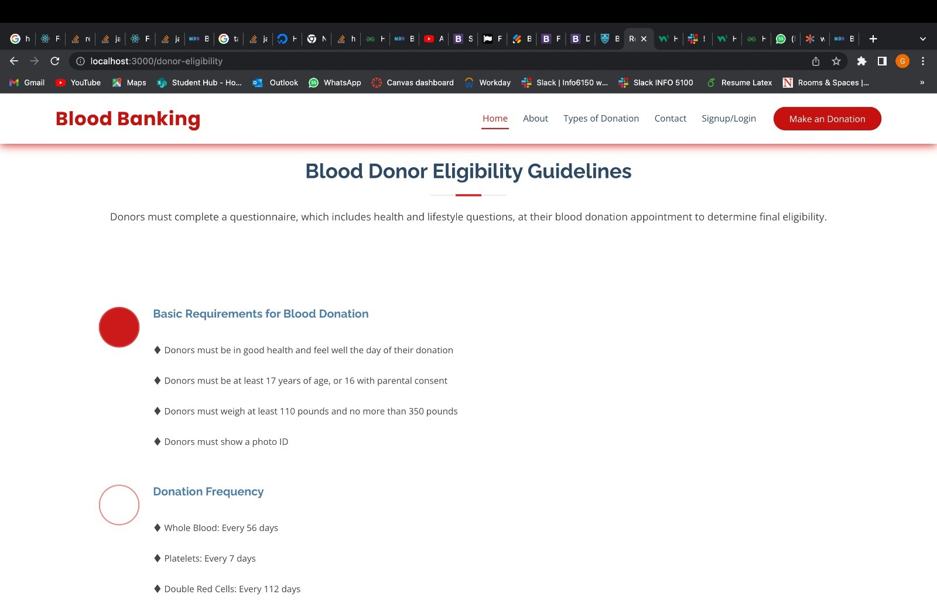

Slide 13
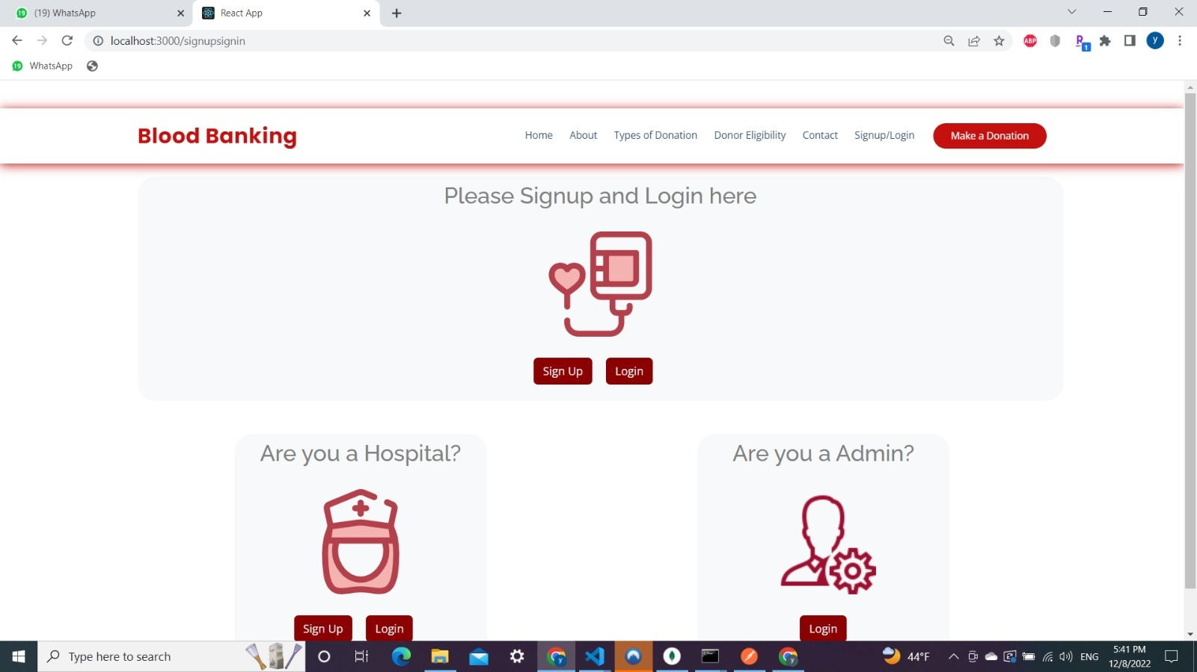
Sign up/ Sign-in Page
Sign up/ Sign in Page View
The Sign up page enables user to register by making an account.
These details are stored in a database which then can be accessed.
Sign in Page is where you can login using your previous credentials

Slide 14
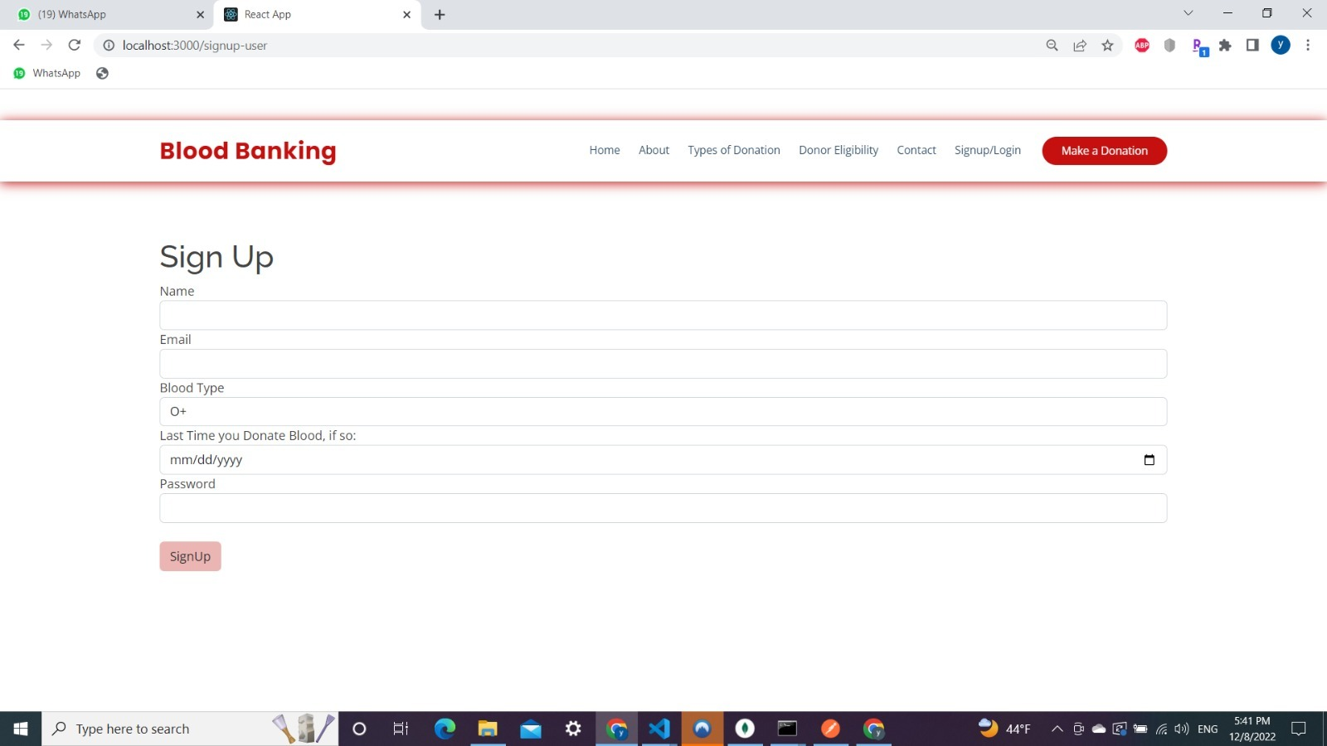

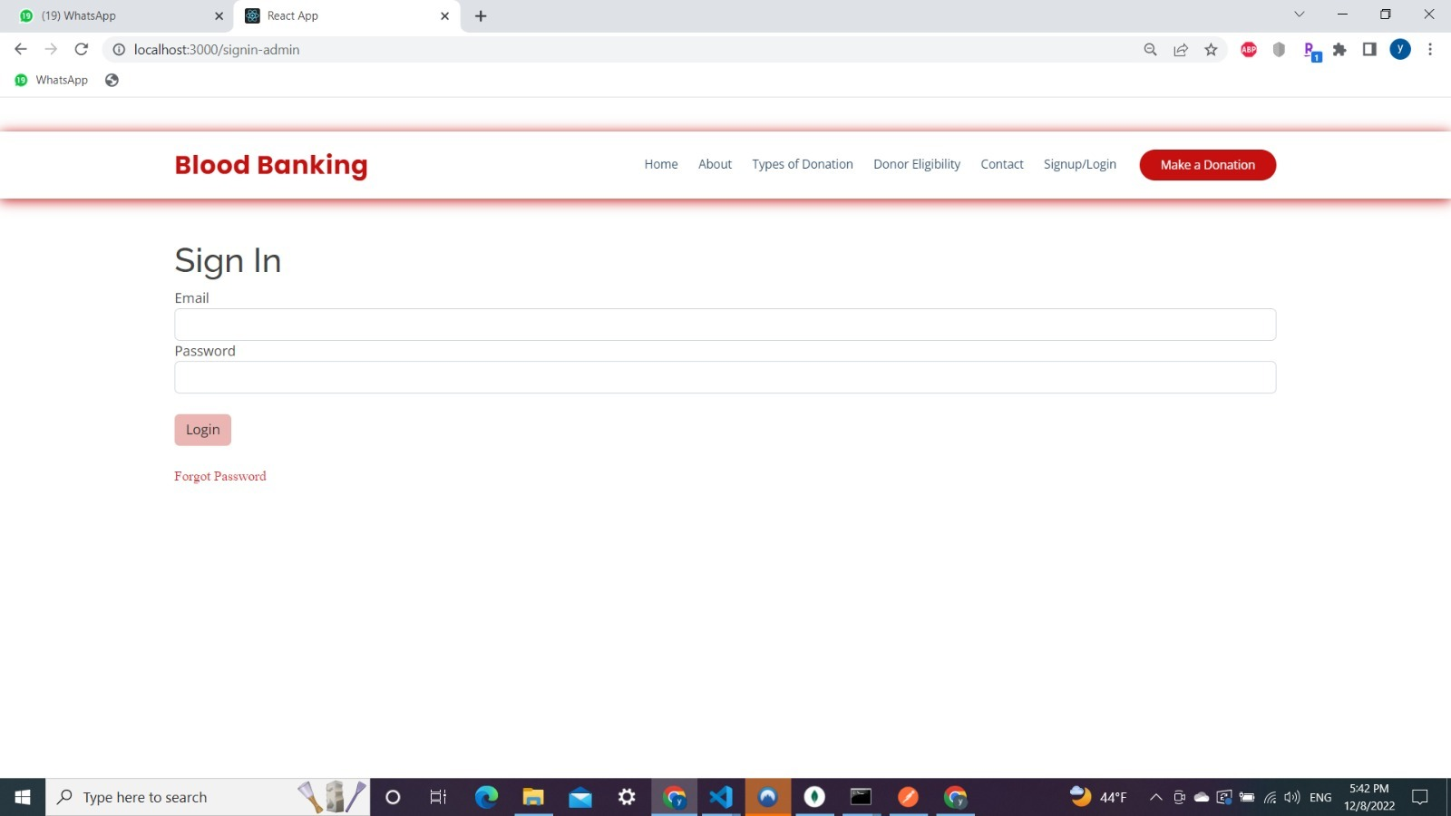
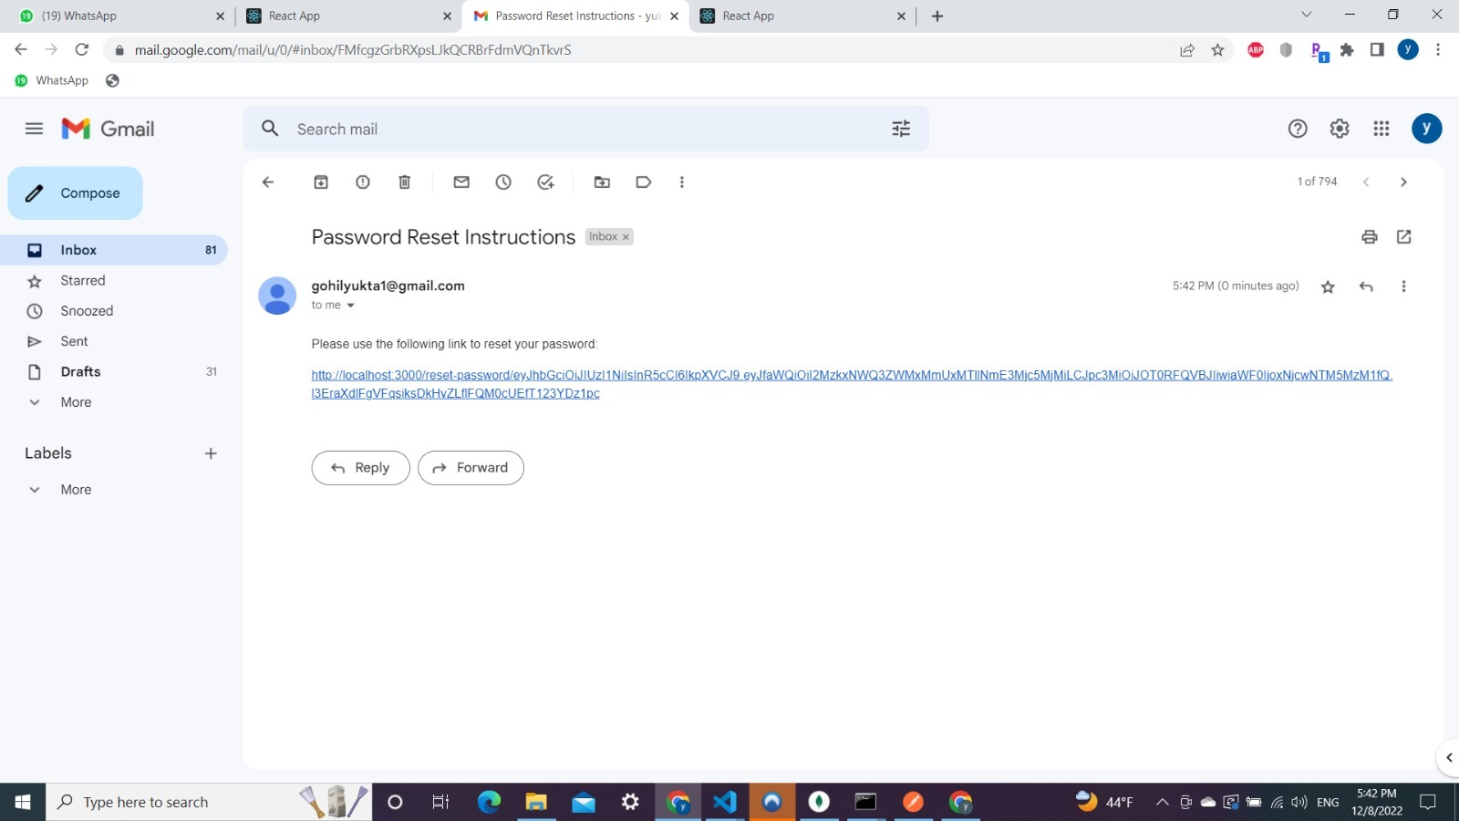

Slide 15
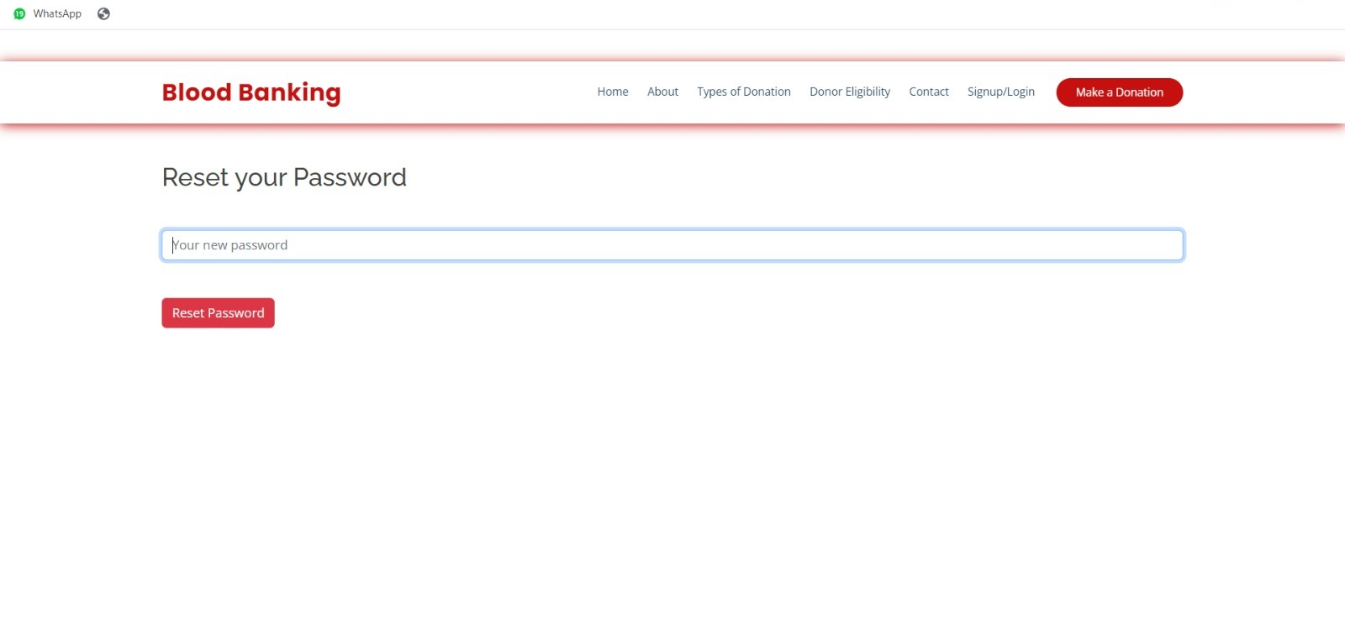

Slide 16
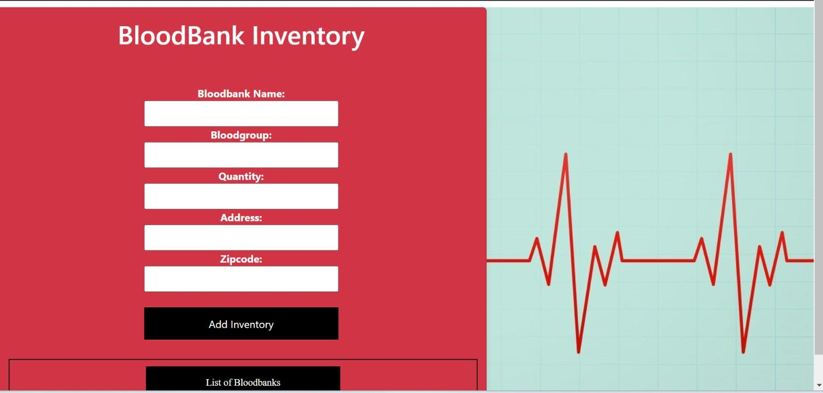
Admin Page
Admin Page View
This is the face of the website.
This page has functionalities like:
View all Appointments
CRUD of Blood-Bank
Add Donor
View Donor
CRUD of Drive Information
View Drive Info Users
CRUD of Hospitals
View all Hospitals to Users
.

Slide 17
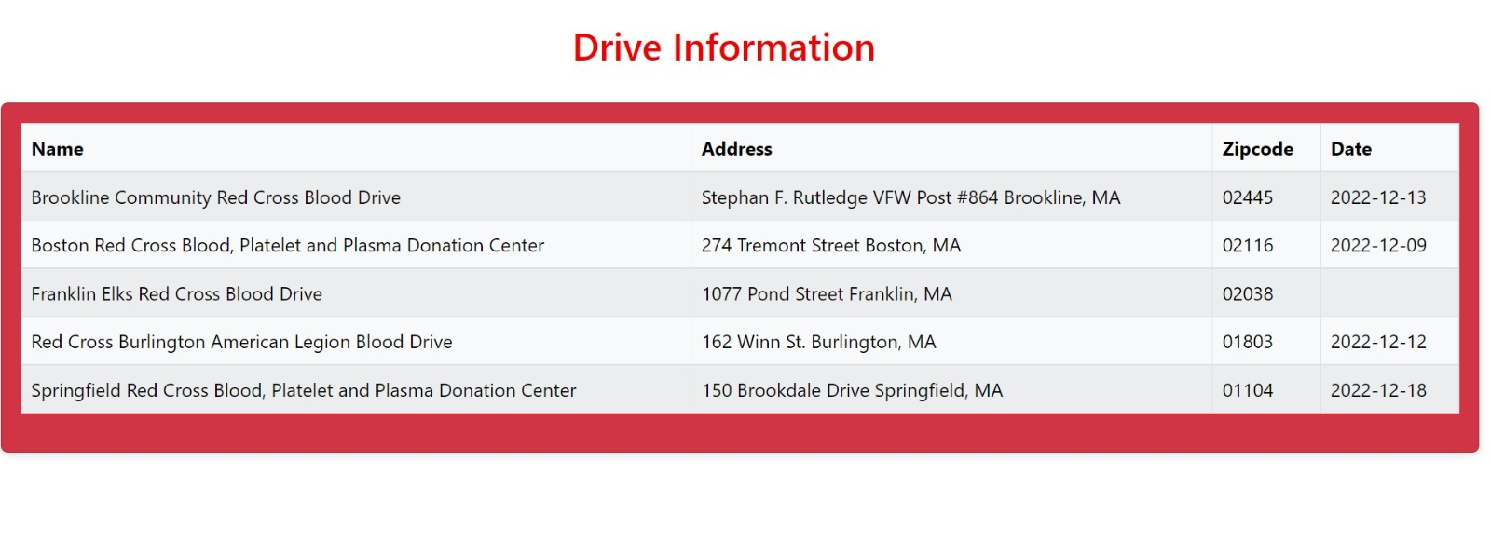
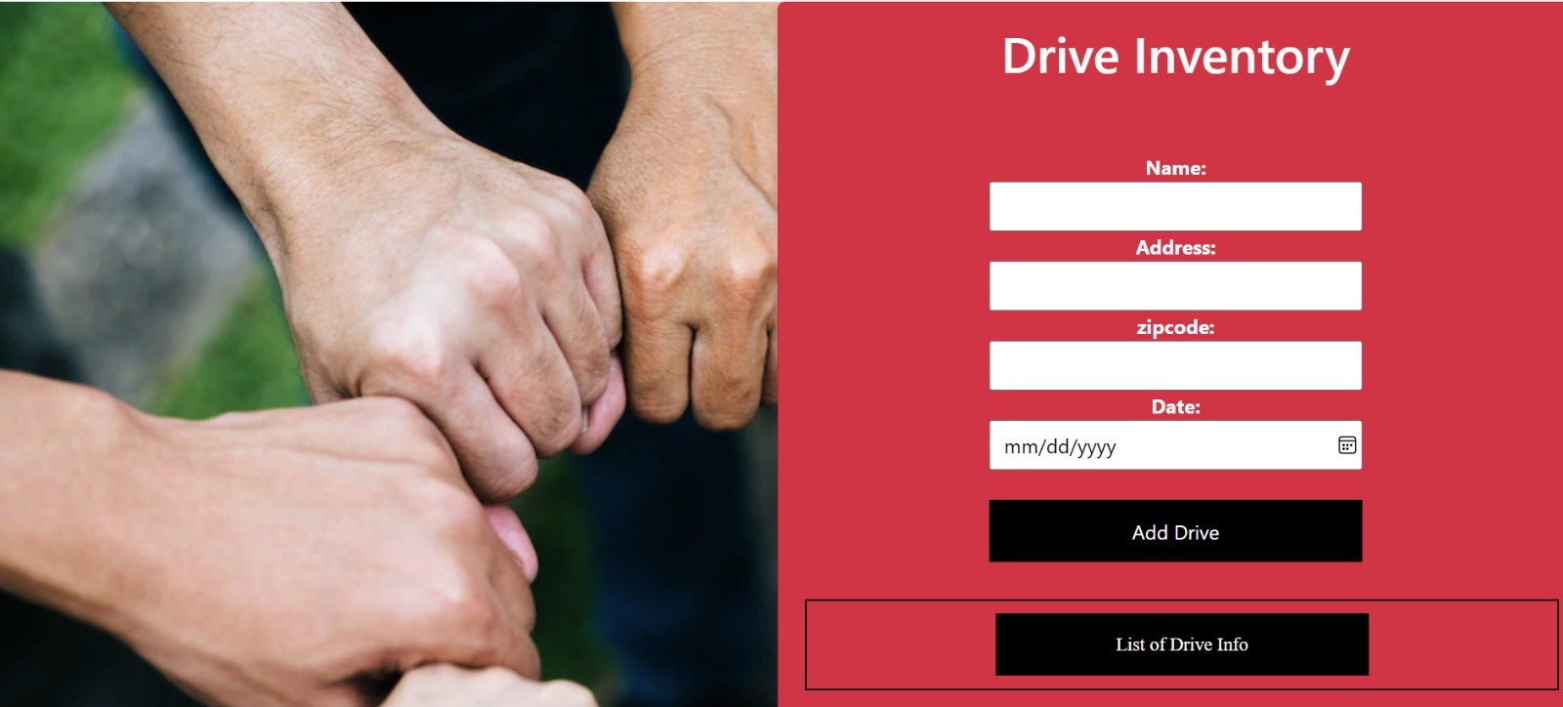
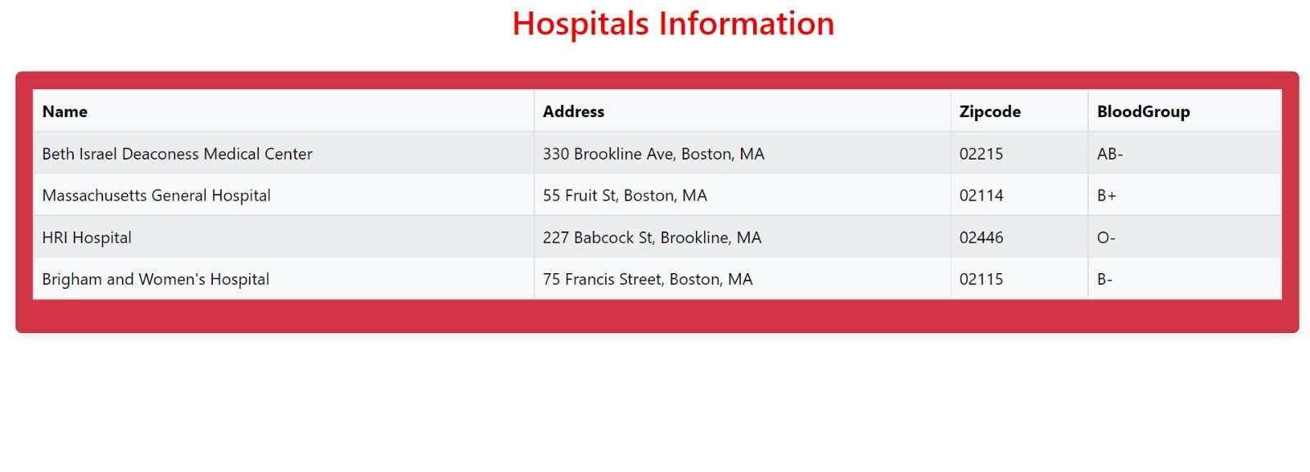
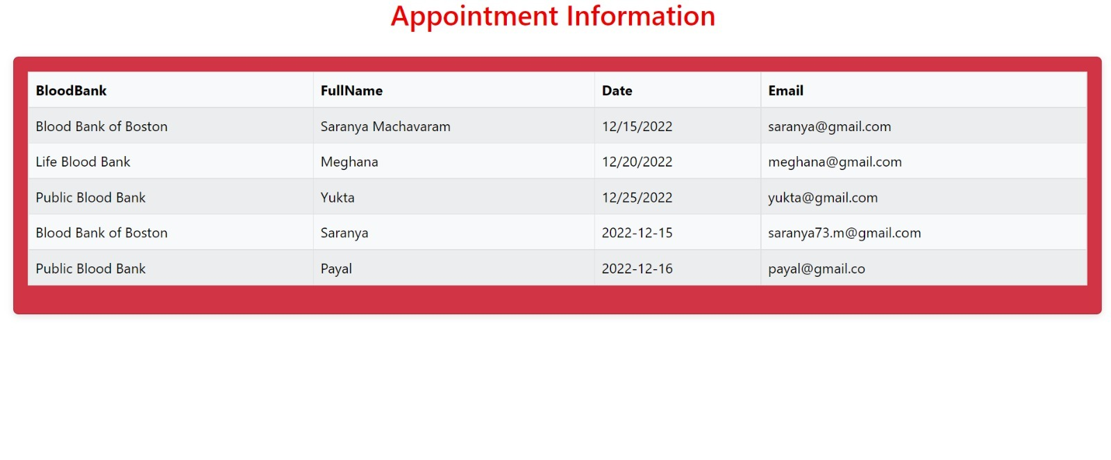
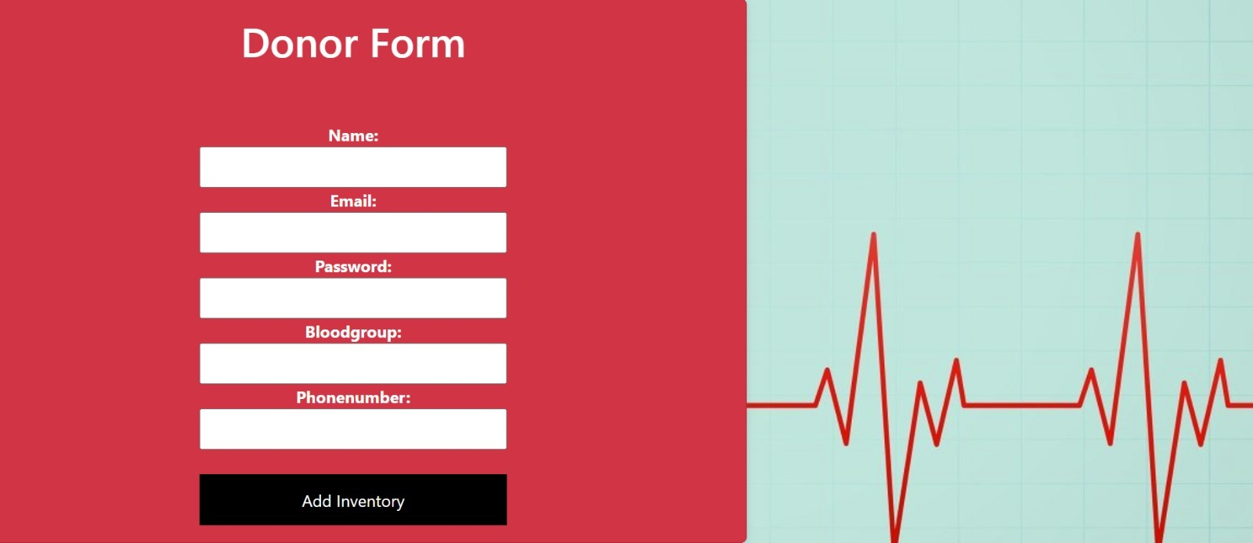

Slide 18
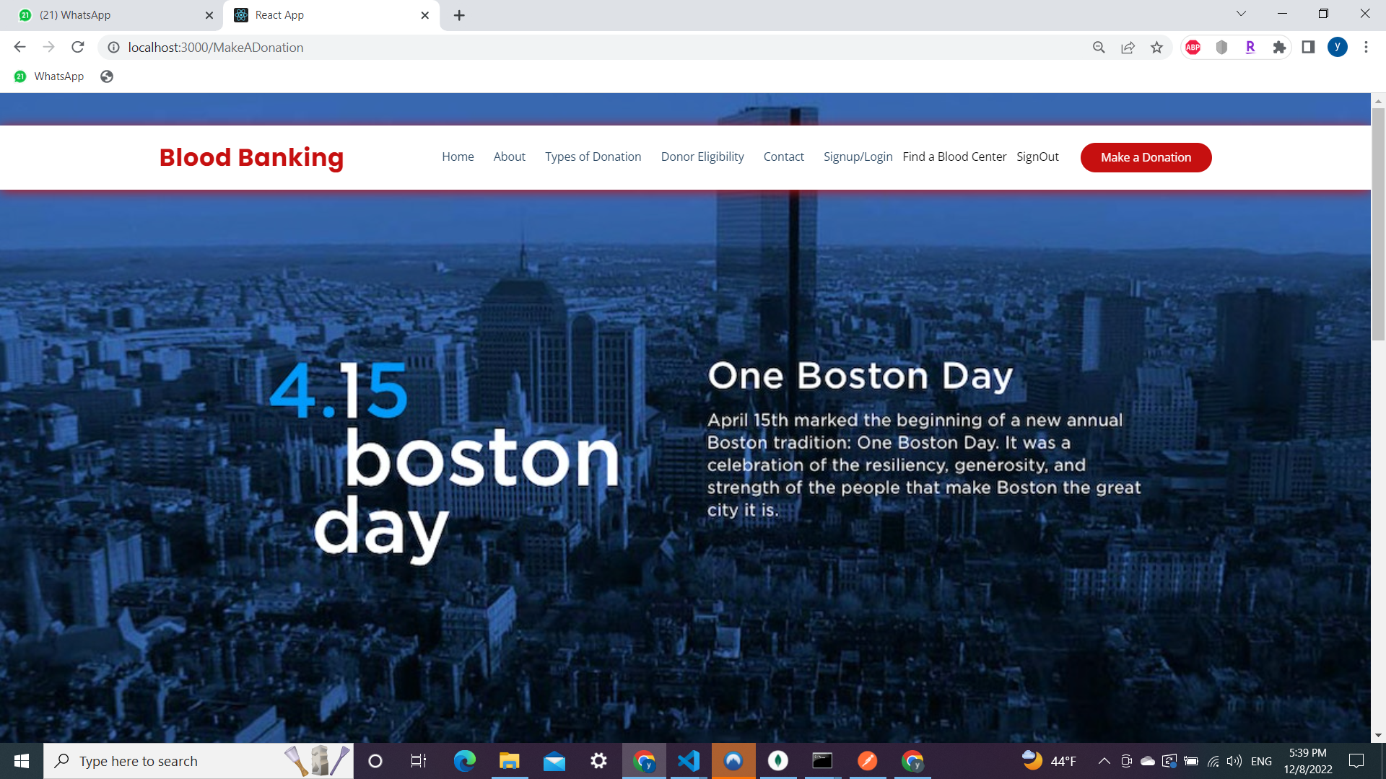
Sponsor Blood Drive
Sponsor Blood Drive View
Sponsor Blood Drive is integrated with PayPal Payment option.

Slide 19
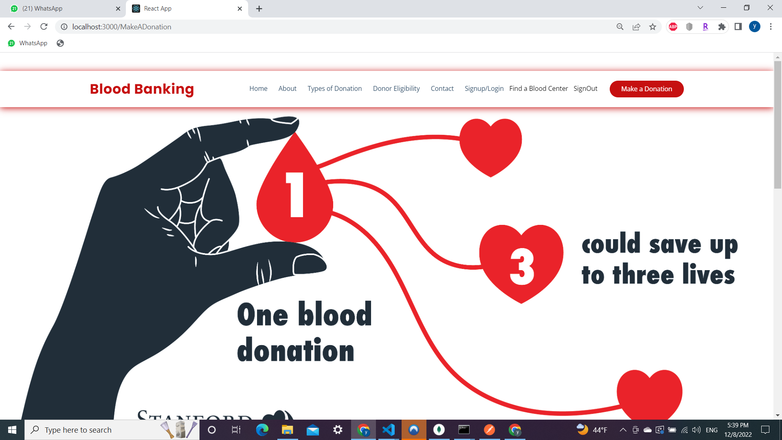
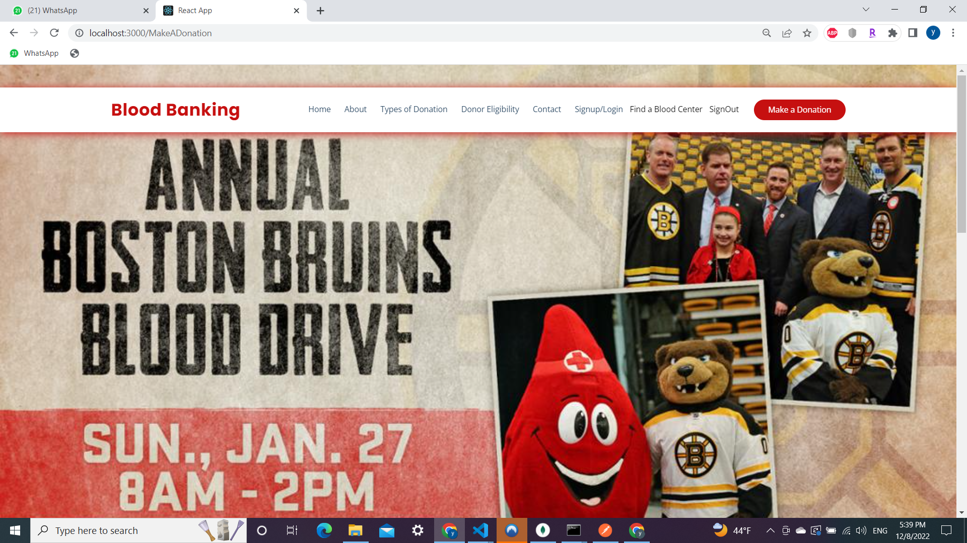

Slide 20
THANKS!

